Slide 1
IS204
System Analysis and Design
System Development
Organizational and Business Context
COMPUTER INFORMATION SYSTEM DEPARTMENT ASS.LEC. ZAINAB H. ALFAYEZ

Slide 2
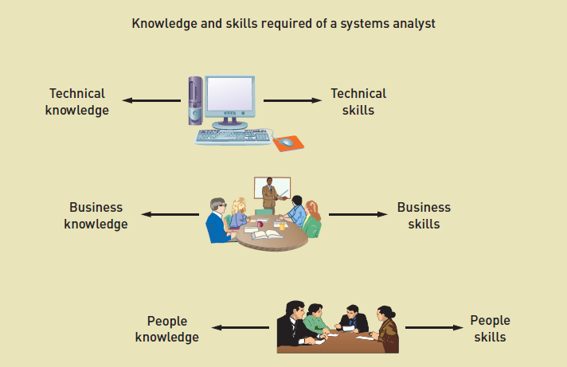
Knowledge and Skills Required of a systems analyst
COMPUTER INFORMATION SYSTEM DEPARTMENT ASS.LEC. ZAINAB H. ALFAYEZ

Slide 3
Knowledge and Skills Required of a systems analyst
Technical Knowledge and Skills
An analyst should have fundamental technology knowledge of:
Computers and how they work.
File, database, and storage hardware and software.
Input and output hardware and software.
Computer networks and protocols.
Programming languages, operating systems, and utilities.
Communication and collaboration technology such as digital telephones, videoconferencing, and Web-based document management systems.
COMPUTER INFORMATION SYSTEM DEPARTMENT ASS.LEC. ZAINAB H. ALFAYEZ

Slide 4
Knowledge and Skills Required of a systems analyst
Technical Knowledge and Skills
Analyst uses tools.
Tools: a software application that assists developers in creating models or other components required for a project.
Examples of tools used in system development:
Software productivity packages: Microsoft Access.
Integrated development environments (IDEs) for programming languages: Microsoft Visual Studio.
COMPUTER INFORMATION SYSTEM DEPARTMENT ASS.LEC. ZAINAB H. ALFAYEZ

Slide 5
Knowledge and Skills Required of a systems analyst
Technical Knowledge and Skills
Analyst understands SDLC techniques.
Examples :
Project planning techniques.
Cost/benefit analysis techniques.
Interviewing techniques.
Requirements modelling techniques.
Architectural design techniques.
Network configuration techniques.
Database design techniques.
COMPUTER INFORMATION SYSTEM DEPARTMENT ASS.LEC. ZAINAB H. ALFAYEZ

Slide 6
Knowledge and Skills Required of a systems analyst
Business Knowledge and Skills
Analyst must understand:
Business functions performed by organization
Strategies, plans, traditions, and values of the organization
Organizational structure
Organization management techniques
Functional work processes
Systems analysts typically study business administration/management in college with a major in CIS or MIS.
COMPUTER INFORMATION SYSTEM DEPARTMENT ASS.LEC. ZAINAB H. ALFAYEZ

Slide 7
Knowledge and Skills Required of a systems analyst
People Knowledge and Skills
Interpersonal skills are perhaps the analyst’s most important skills because analysts rely on others, including managers, users, programmers, technical specialists, customers, and vendors, to take a system from initial idea to final implementation.
The analyst must develop rapport with users who may be resistant to change, negotiate with management for such resources as budget, time, and personnel, and manage development personnel with many different skills, capabilities, and attitudes.
The analyst must be an effective teacher, mentor, confidant, collaborator, manager, and leader, shifting easily among those roles many times over the course of a typical work day.
COMPUTER INFORMATION SYSTEM DEPARTMENT ASS.LEC. ZAINAB H. ALFAYEZ

Slide 8
Knowledge and Skills Required of a systems analyst
Integrity and Ethics
Must keep information private
Any impropriety can ruin an analyst’s career
Analyst plans security in systems to protect confidential information.
COMPUTER INFORMATION SYSTEM DEPARTMENT ASS.LEC. ZAINAB H. ALFAYEZ

Slide 9
Analysis Related Careers
Many software development jobs have shifted to companies that produce and sell ERP and package software.
Changes in software development, technology, and business practices have created many new career opportunities for analysts, including:
sales and support of ERP software
business analysts for user organizations
auditing, compliance, and security
Web development.
COMPUTER INFORMATION SYSTEM DEPARTMENT ASS.LEC. ZAINAB H. ALFAYEZ

Slide 10
A Variety of Job Titles
Programmer analyst
Business systems analyst
System liaison
End-user analyst
Business consultant
Systems consultant
Systems support analyst
Systems designer
Software engineer
System architect
Web architect / Webmaster /Web developer
COMPUTER INFORMATION SYSTEM DEPARTMENT ASS.LEC. ZAINAB H. ALFAYEZ

